Slide 1

Environmental Degradation of Materials
Dr. J. Venkatramani
219-B
venkatramani@iiitdm.ac.in

Slide 2
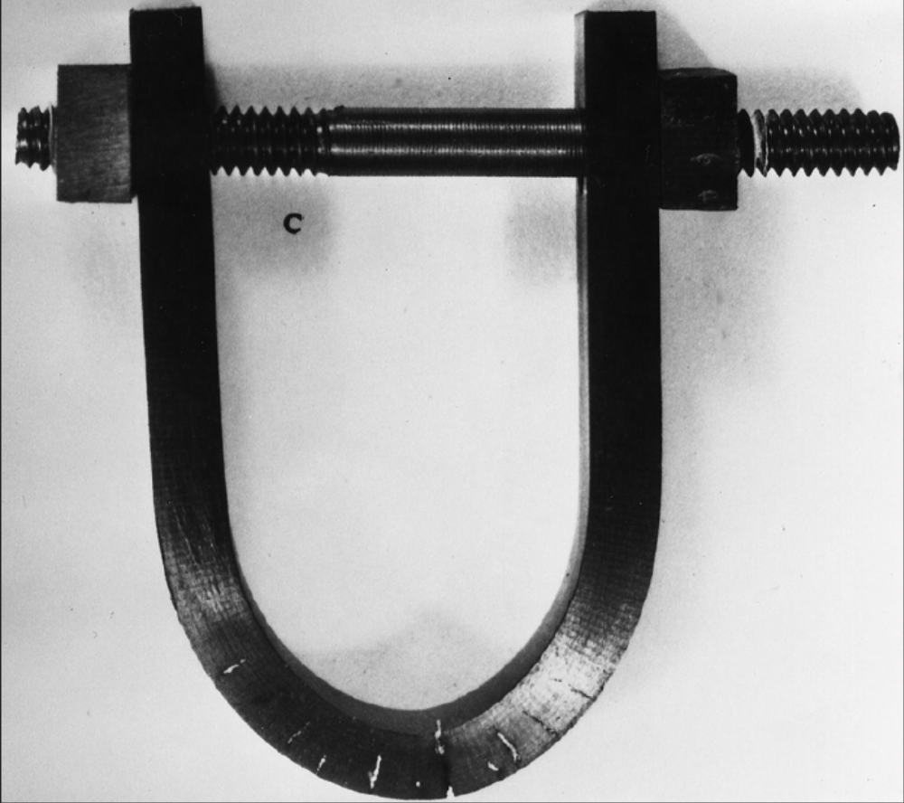
Corrosion and Degradation of Materials
Stress Corrosion Cracking

Slide 3
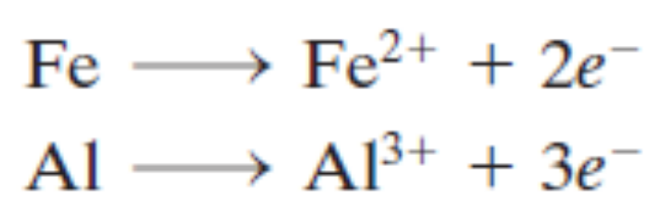
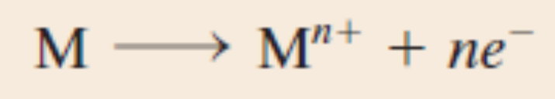
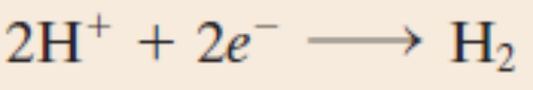

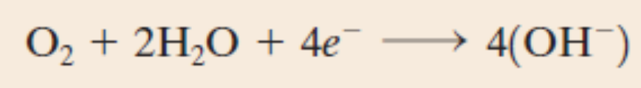
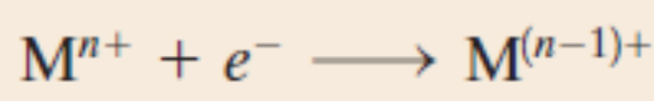
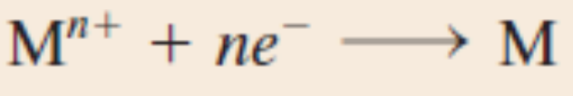
Corrosion and Degradation of Materials
Electrochemistry
Oxidation Reactions at Anode:
Reduction Reactions at Cathode:

Slide 4
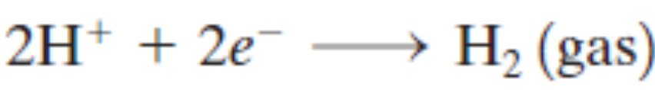

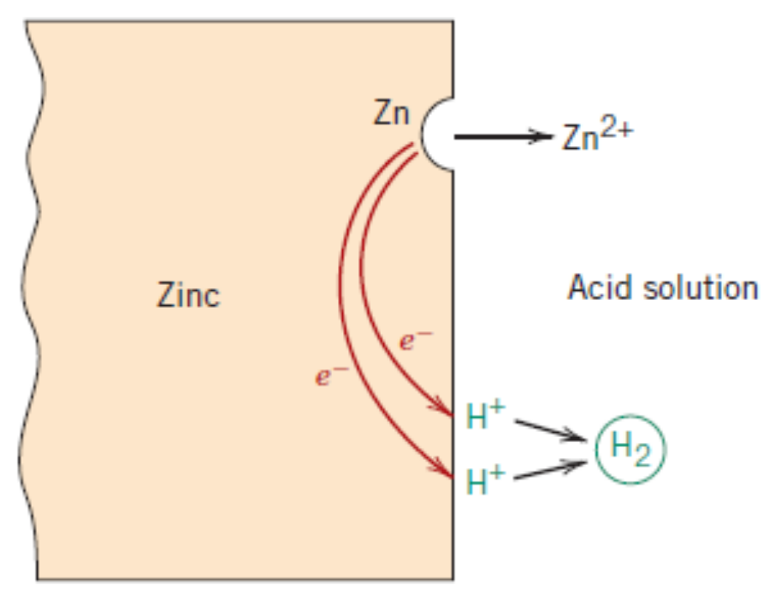
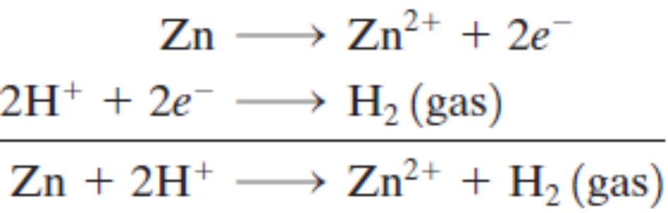
Corrosion and Degradation of Materials
Electrochemistry – Example: Corrosion of Zinc
Reduction Reaction at Cathode:
Oxidation Reaction at Anode:
Total electrochemical reaction
Corrosion of Zinc

Slide 5
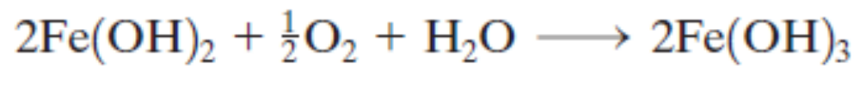
Corrosion and Degradation of Materials
Electrochemistry – Example: Rusting of Iron
Electrochemical reaction takes place in two stages

Slide 6
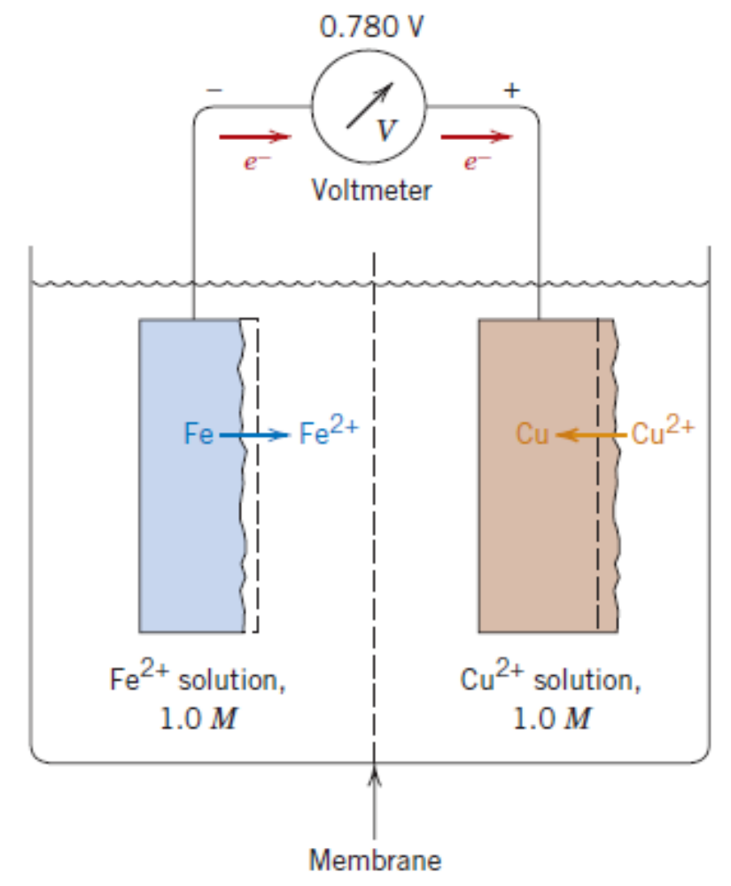
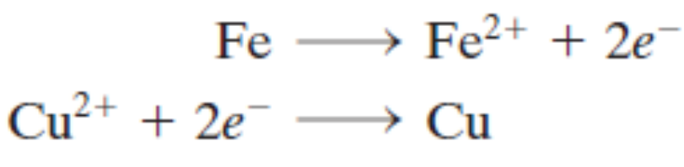
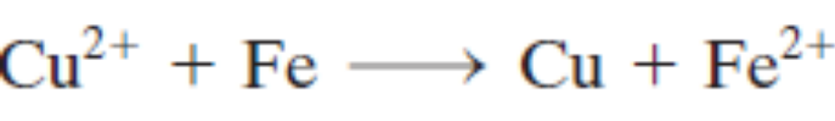
Corrosion and Degradation of Materials
Concept of Electrode Potential
Not all metallic materials oxidize to form ions with same degree of ease.
Total electrochemical reaction

Slide 7
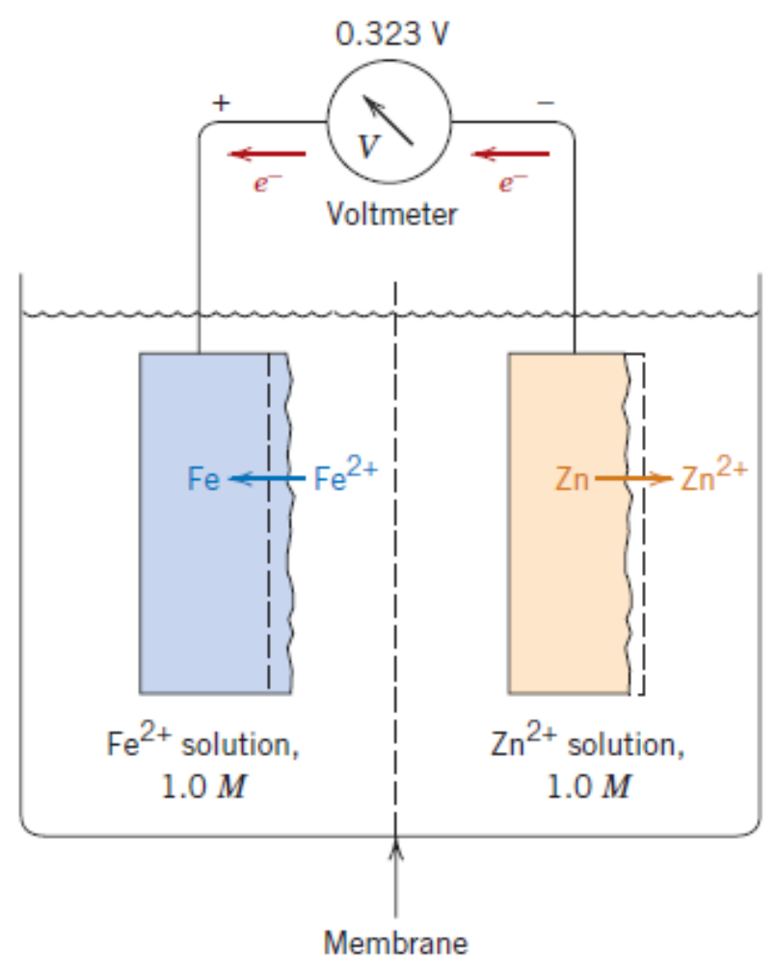

Corrosion and Degradation of Materials
Concept of Electrode Potential
Not all metallic materials oxidize to form ions with same degree of ease.
Total electrochemical reaction

Slide 8
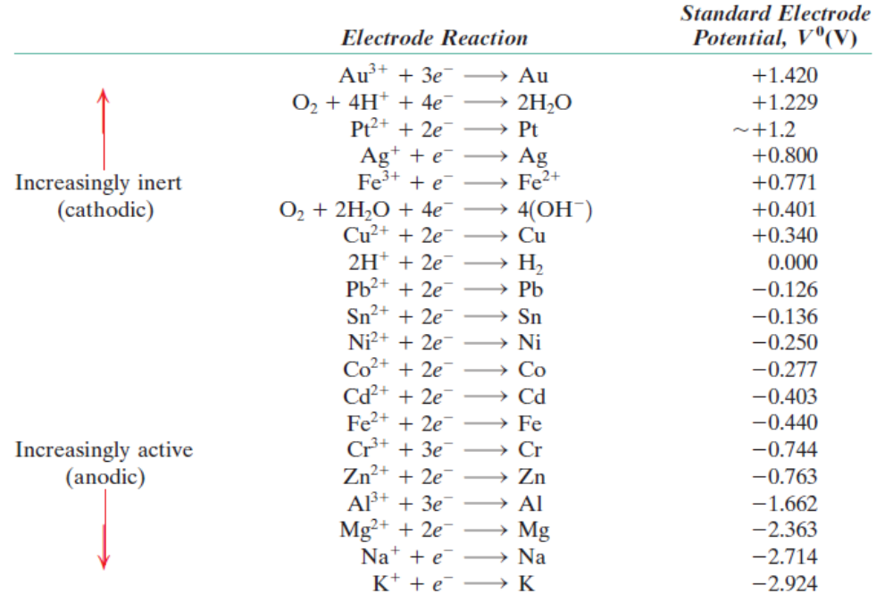
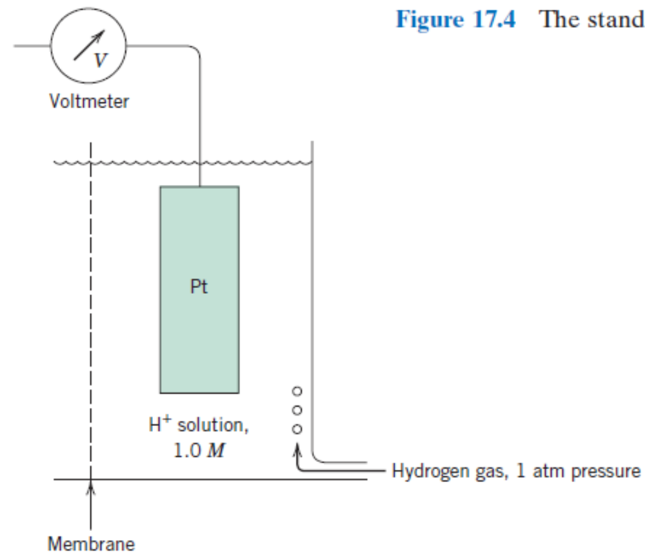
Corrosion and Degradation of Materials
Standard EMF Series

Slide 9
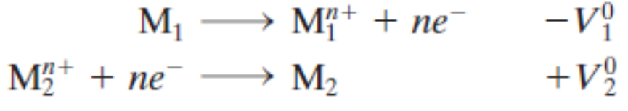

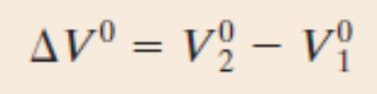
Corrosion and Degradation of Materials
Standard EMF Series
Total electrochemical reaction
With the overall cell potential of
ΔV⁰, given by,

Slide 10
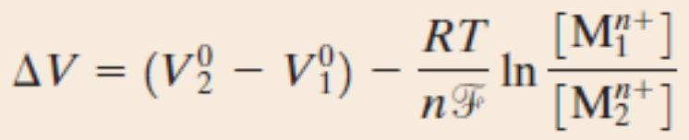
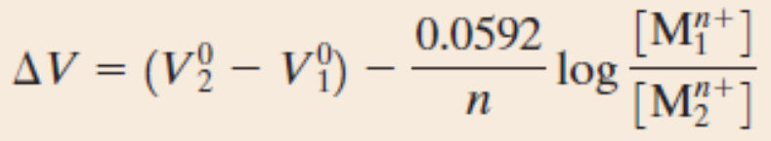
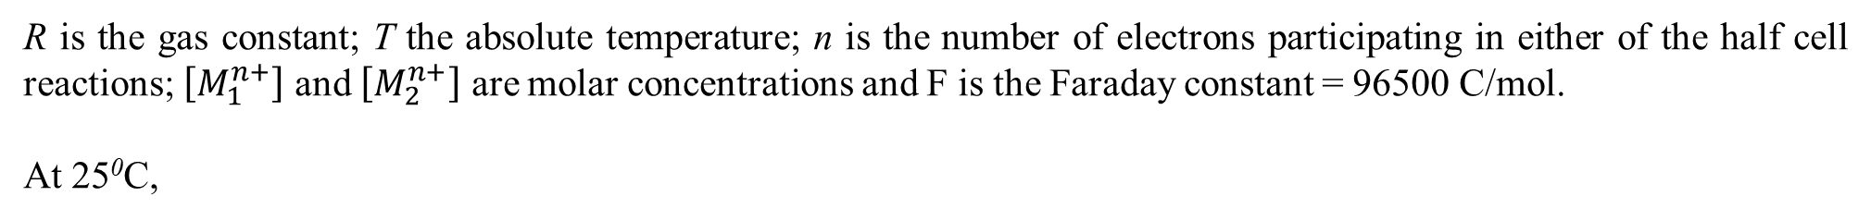
Corrosion and Degradation of Materials
Influence of Concentration and Temperature
Nernst equation:
R is the gas constant; T the absolute temperature; n is the number of electrons participating in either of the half cell reactions; $\left[M_{1}^{n+}\right]$ and $\left[M_{2}^{n+}\right]$ are molar concentrations and F is the Faraday constant = 96500 C/mol.
At 25⁰C,

Slide 11
Corrosion and Degradation of Materials
Problem: One-half of an electrochemical cell consists of a pure nickel electrode in a solution of Ni²⁺ ions; the other half is a cadmium electrode immersed in a Cd²⁺ solution.
If the cell is a standard one, write the spontaneous overall reaction and calculate the voltage that is generated.
Compute the cell potential at 25⁰C if the Cd²⁺ and Ni2⁺ concentrations are 0.5 and 0.001 M, respectively. Is the spontaneous reaction direction still the same as for the standard cell?

Slide 12
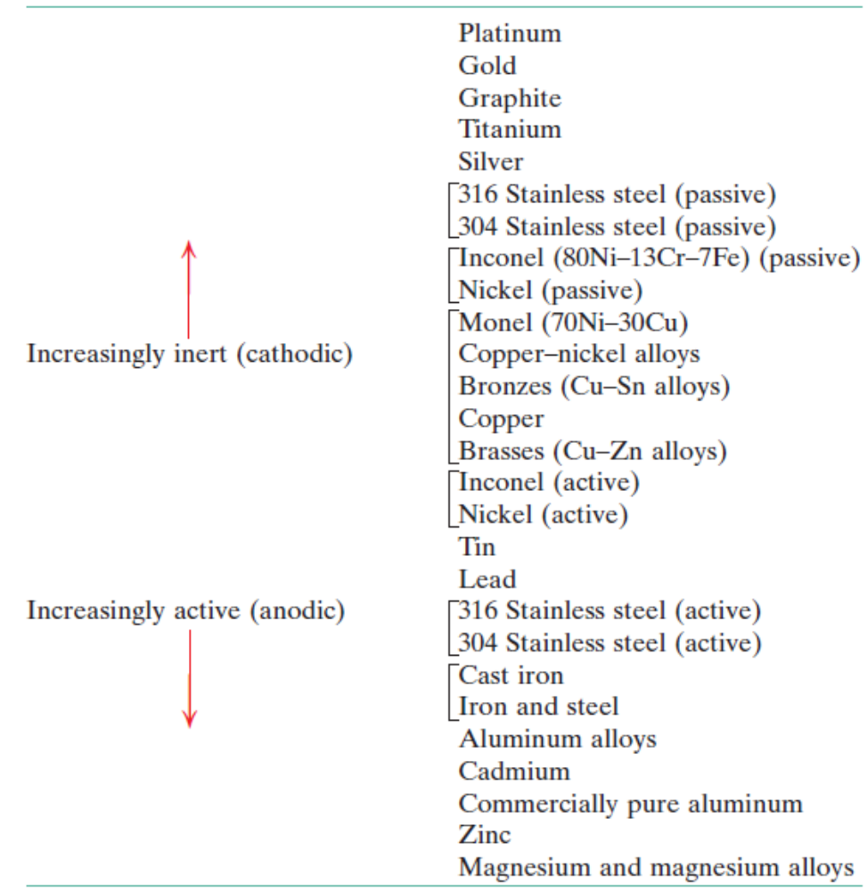
Corrosion and Degradation of Materials
Galvanic Series
– a more realistic and practical ranking

Slide 13
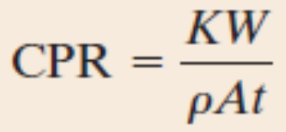
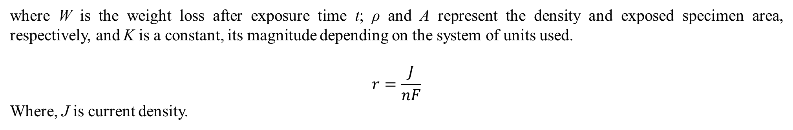
Corrosion and Degradation of Materials
Quantifying corrosion rates
Corrosion penetration rate (CPR):
where W is the weight loss after exposure time t; ρ and A represent the density and exposed specimen area, respectively, and K is a constant, its magnitude depending on the system of units used.
$$r=\frac{J}{nF}$$
Where, J is current density.

Slide 14
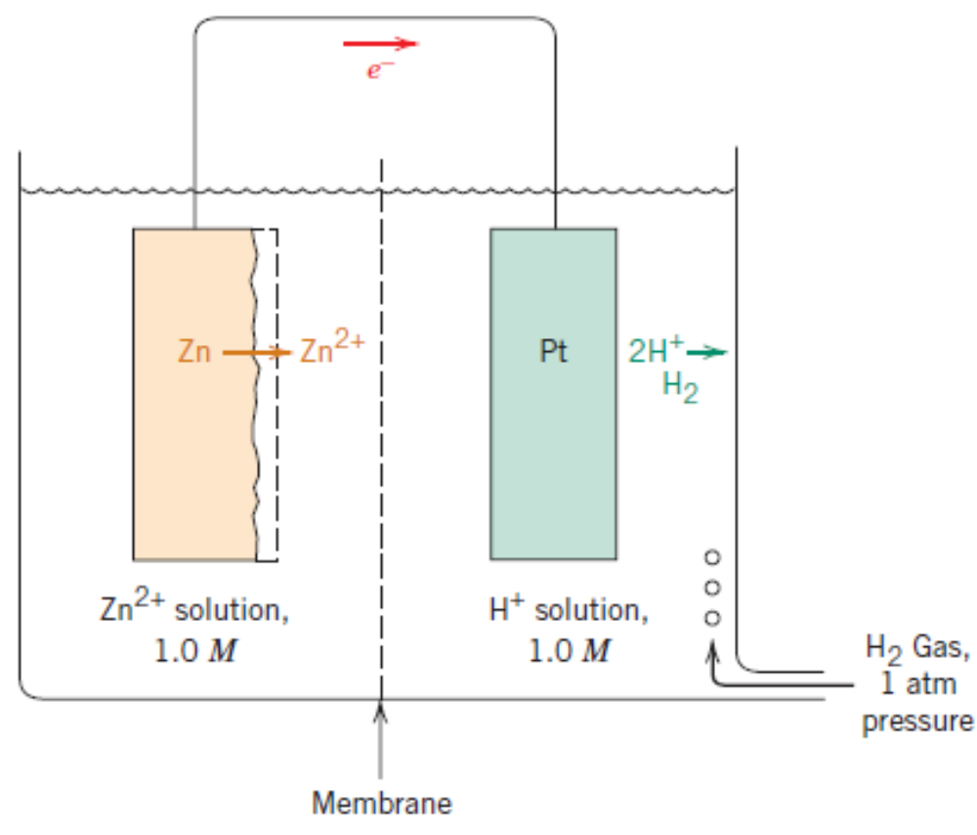
Corrosion and Degradation of Materials
Prediction of corrosion Rates – Polarization
When the electrochemical reaction in not in equilibrium, there will be a difference between the emf generated and the standard emf. This difference is called overvoltage, denoted by η. The displacement of each electrode voltage potential from equilibrium is called Polarization.
Example: Zn cell connected to a standard cell, actual emf
Registered is – 0.621 V. Then,
η = – 0.621 – (–0.763) = 0.142 V

Slide 15
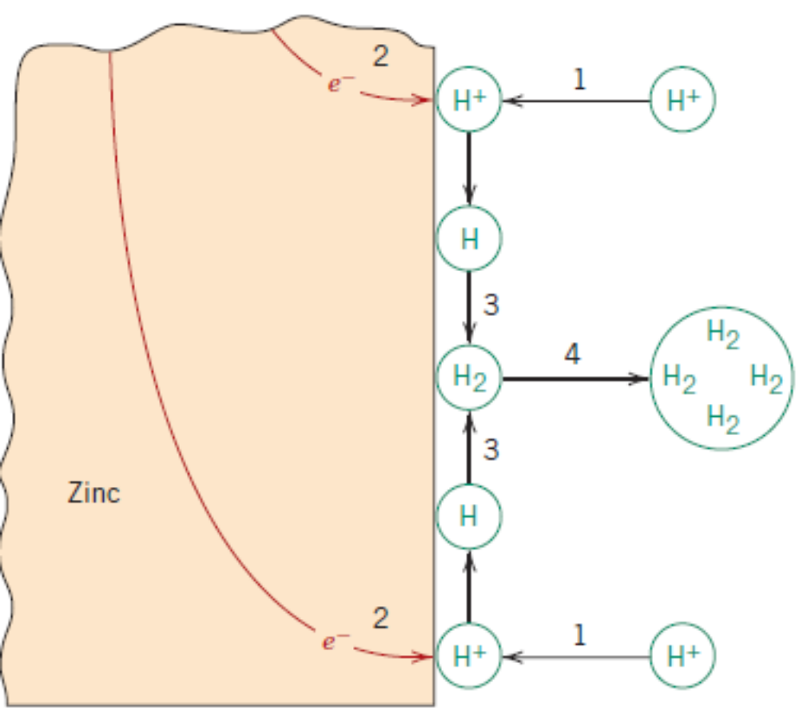
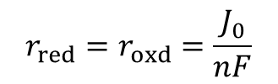
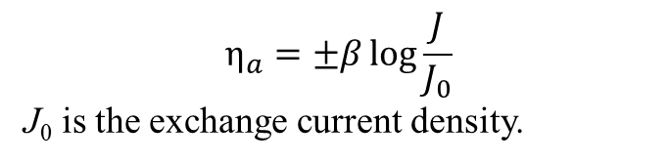
Corrosion and Degradation of Materials
Prediction of corrosion Rates – Activation Polarization
The rate of reaction is controlled by the slowest step involved. This step has an activation barrier (energy) which has to be overcome.
$$η_{a}=±β\log{\frac{J}{J_{0}}}$$
J₀ is the exchange current density.
Physical significance of J₀: When the electrochemical reaction is at equilibrium for a standard half – cell, the rates of reduction (r_{red}) and oxidation (r_{oxid}) are same and can be written as follows from the earlier definition of rate.
$$r_{red}=r_{oxd}=\frac{J_{0}}{nF}$$

Slide 16
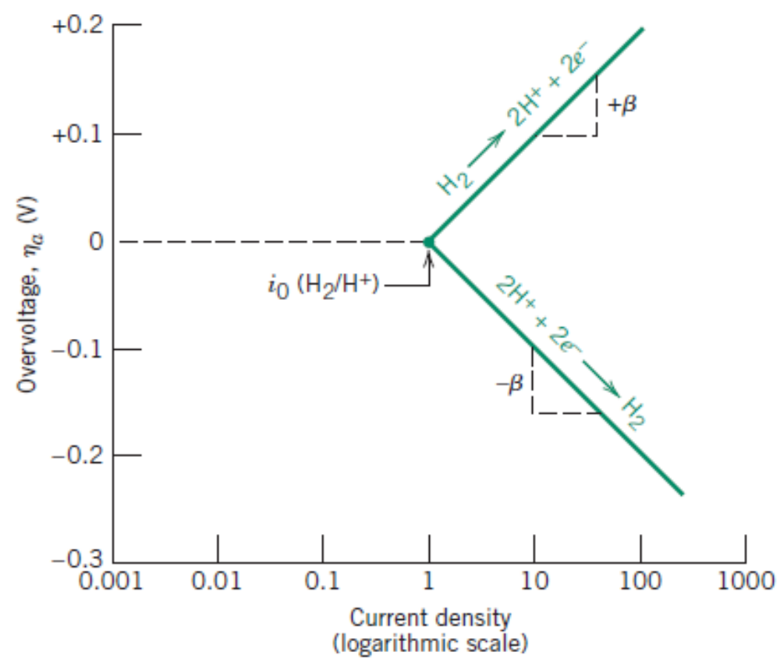
Corrosion and Degradation of Materials
Prediction of corrosion Rates – Activation Polarization
Plot of overvoltage for Hydrogen electrode.
J₀

Slide 17
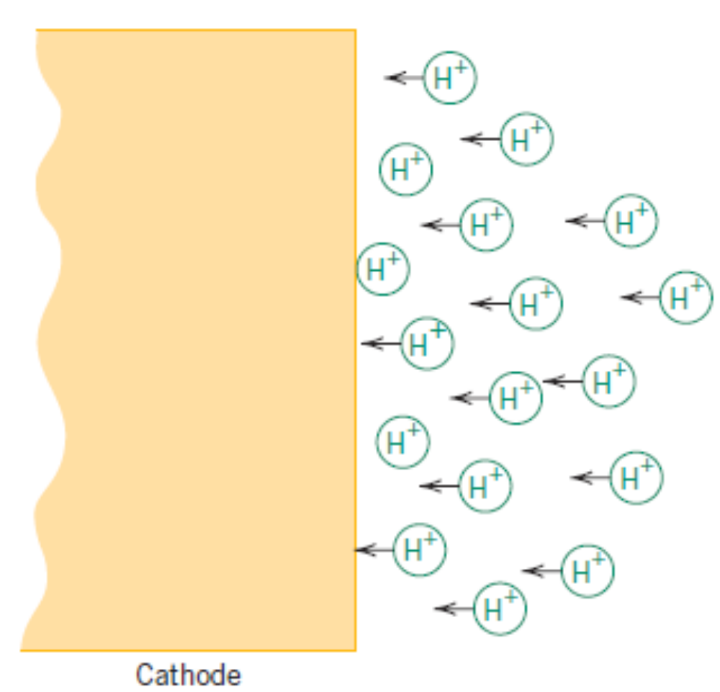
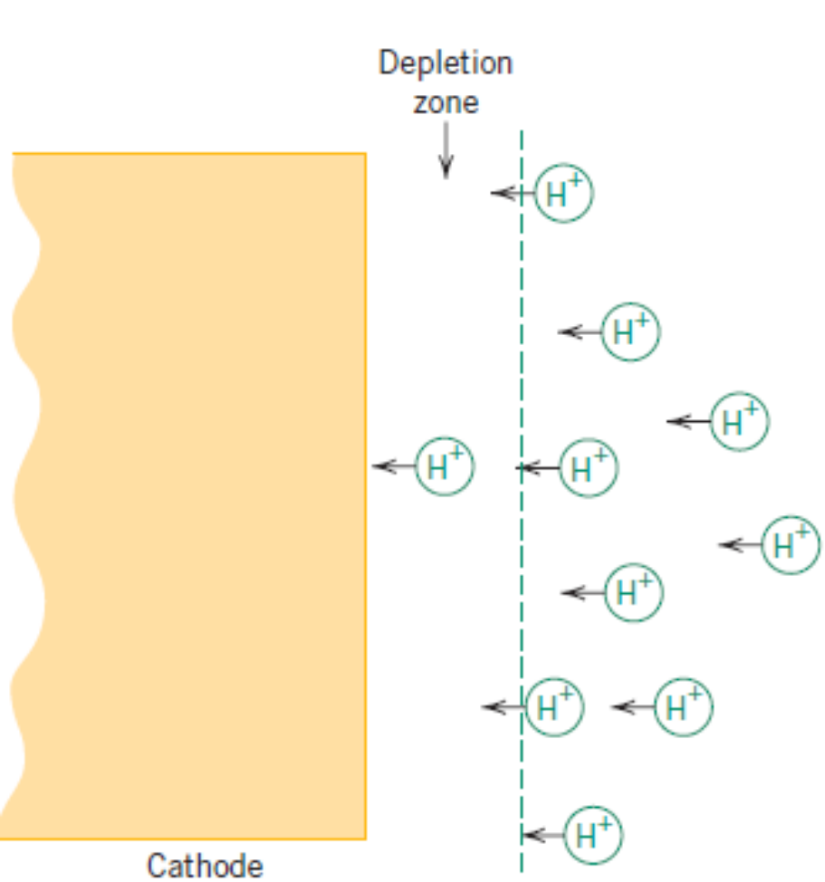
Corrosion and Degradation of Materials
Prediction of corrosion Rates – Concentration Polarization
Low reaction rates and high concentrations
High reaction rates and low concentrations

Slide 18
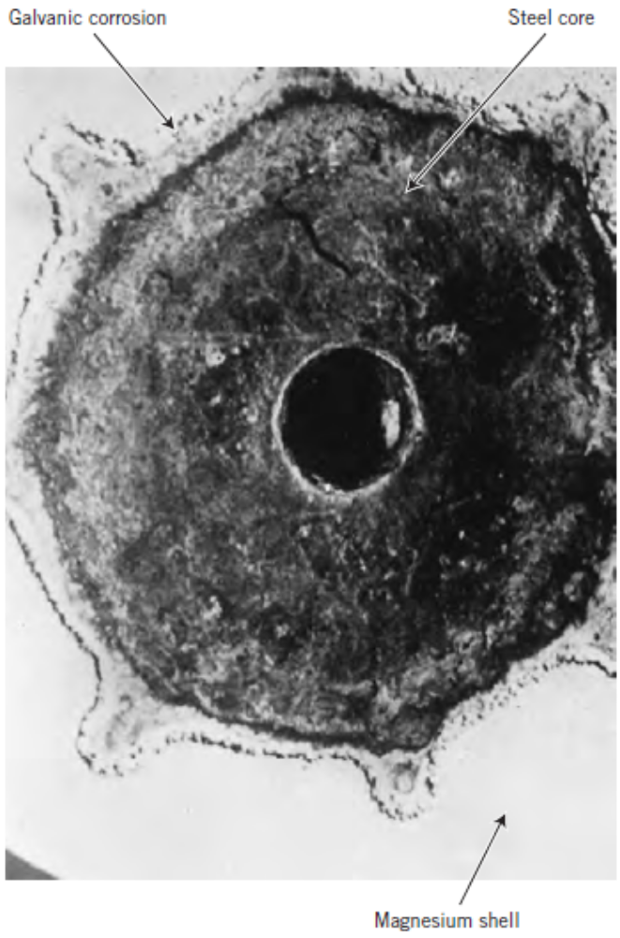
Corrosion and Degradation of Materials
Forms of Corrosion
Uniform Attack
Galvanic Corrosion
Crevice Corrosion
Pitting Corrosion
Intergranular Corrosion
Selective Leaching
Erosion Corrosion
Stress Corrosion
Hydrogen Embrittlement

Slide 19
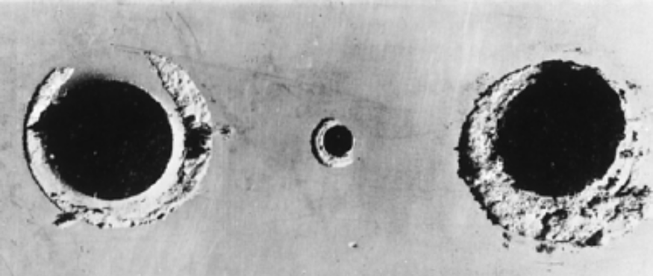
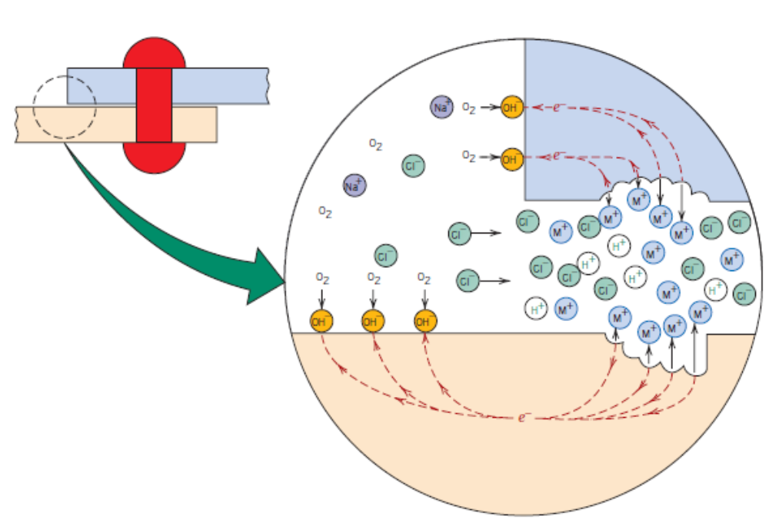
Corrosion and Degradation of Materials
Forms of Corrosion
Uniform Attack
Galvanic Corrosion
Crevice Corrosion
Pitting Corrosion
Intergranular Corrosion
Selective Leaching
Erosion Corrosion
Stress Corrosion
Hydrogen Embrittlement

Slide 20
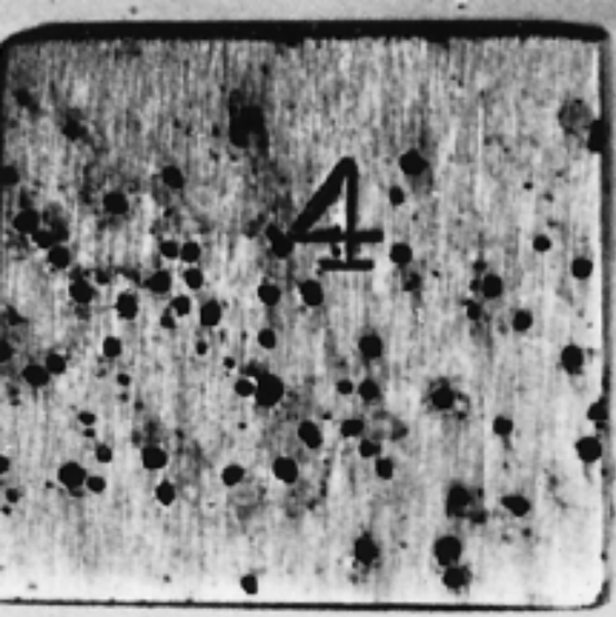
Corrosion and Degradation of Materials
Forms of Corrosion
Uniform Attack
Galvanic Corrosion
Crevice Corrosion
Pitting Corrosion
Intergranular Corrosion
Selective Leaching
Erosion Corrosion
Stress Corrosion
Hydrogen Embrittlement

Slide 21
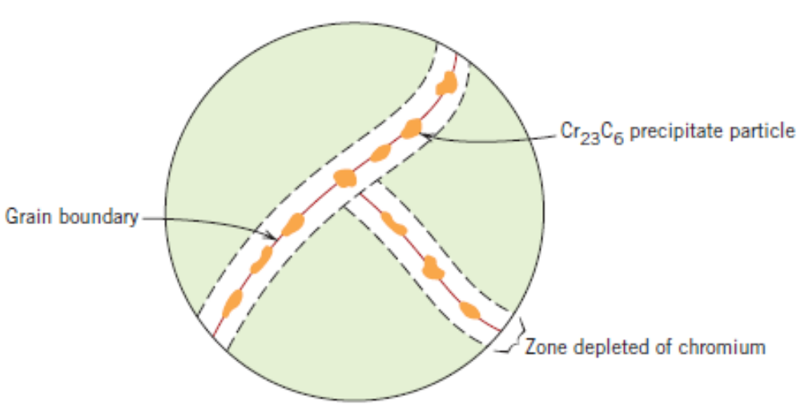
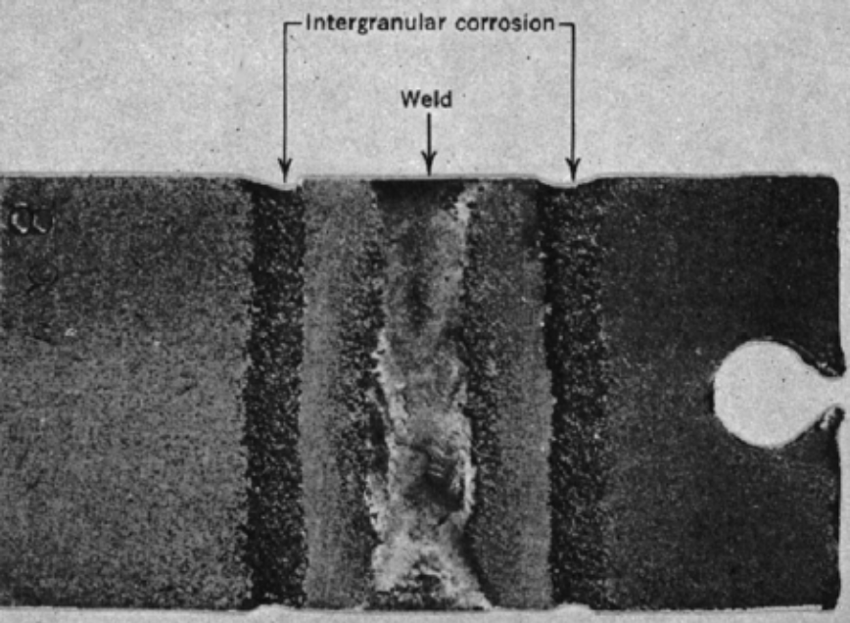
Corrosion and Degradation of Materials
Forms of Corrosion
Uniform Attack
Galvanic Corrosion
Crevice Corrosion
Pitting Corrosion
Intergranular Corrosion
Selective Leaching
Erosion Corrosion
Stress Corrosion
Hydrogen Embrittlement

Slide 22
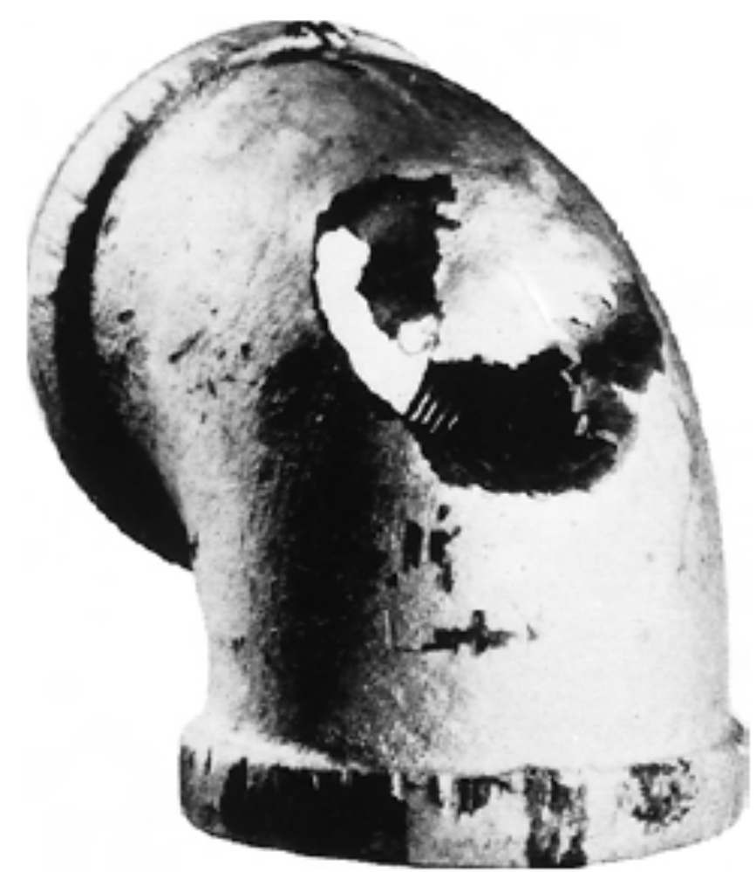
Corrosion and Degradation of Materials
Forms of Corrosion
Uniform Attack
Galvanic Corrosion
Crevice Corrosion
Pitting Corrosion
Intergranular Corrosion
Selective Leaching
Erosion Corrosion
Stress Corrosion
Hydrogen Embrittlement

Slide 23
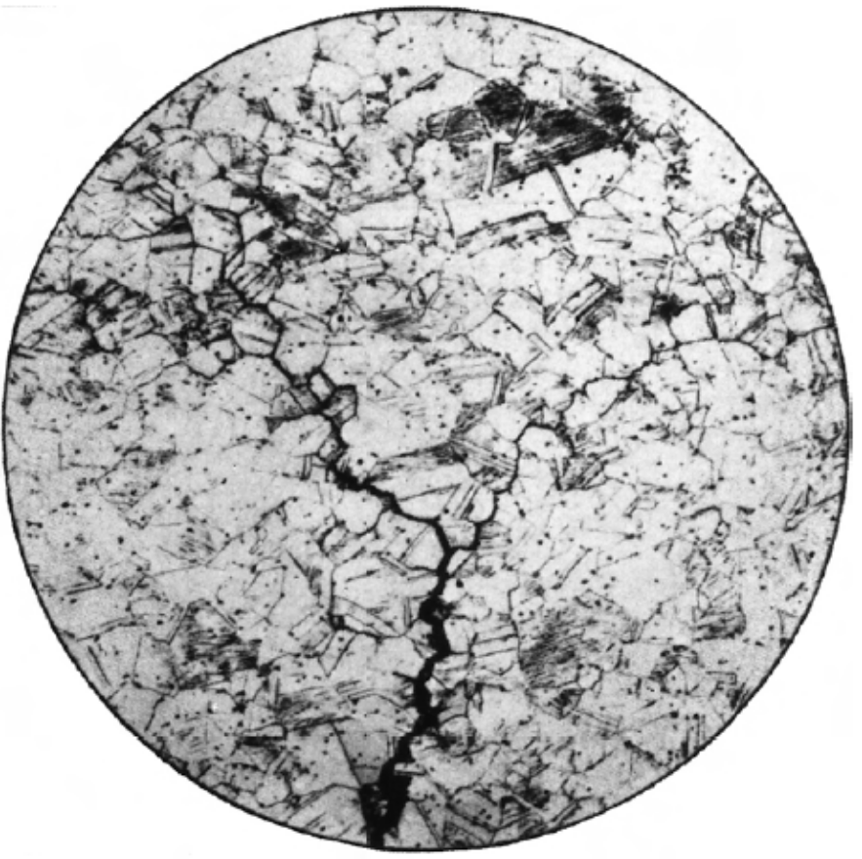
Corrosion and Degradation of Materials
Forms of Corrosion
Uniform Attack
Galvanic Corrosion
Crevice Corrosion
Pitting Corrosion
Intergranular Corrosion
Selective Leaching
Erosion Corrosion
Stress Corrosion
Hydrogen Embrittlement

Slide 24
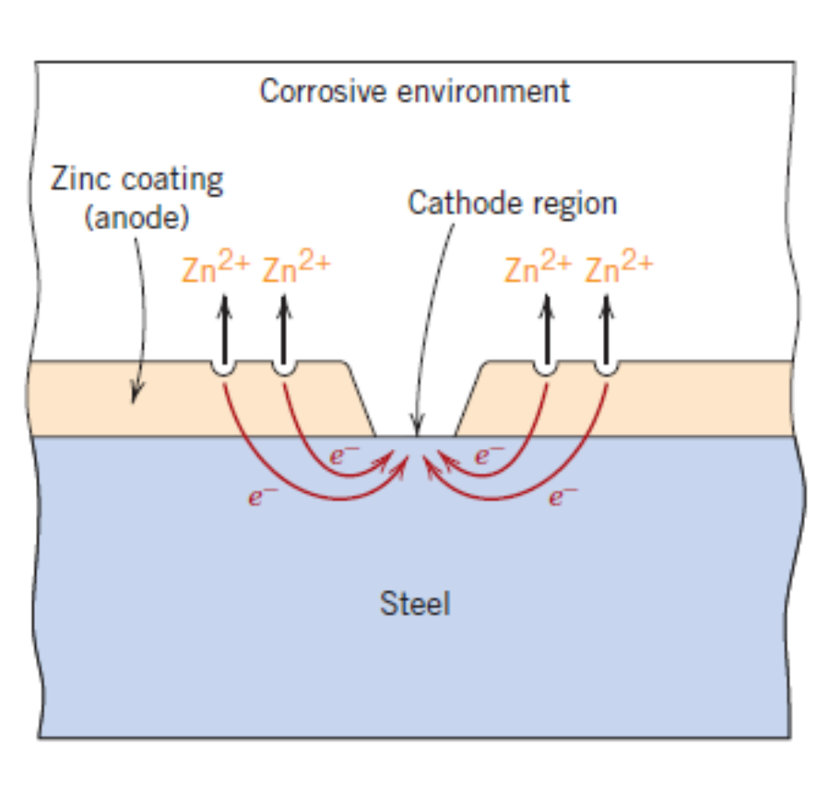
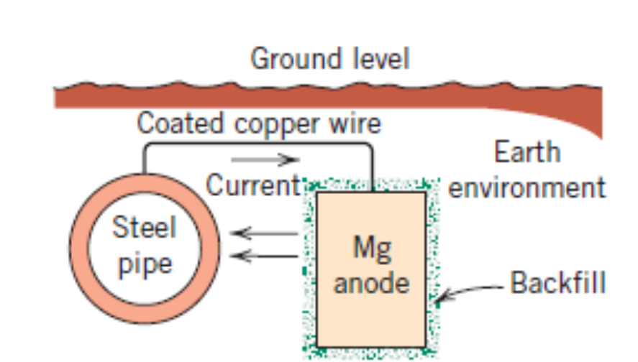
Corrosion and Degradation of Materials
Corrosion Prevention
A judicious choice of materials depending upon the type of environment.
Changing the environmental conditions such as reduced fluid velocity, temperature; modifying the concentrations in the solutions
Use of inhibitors – depending upon the type of metal
Coatings
Cathodic Protection

Slide 25
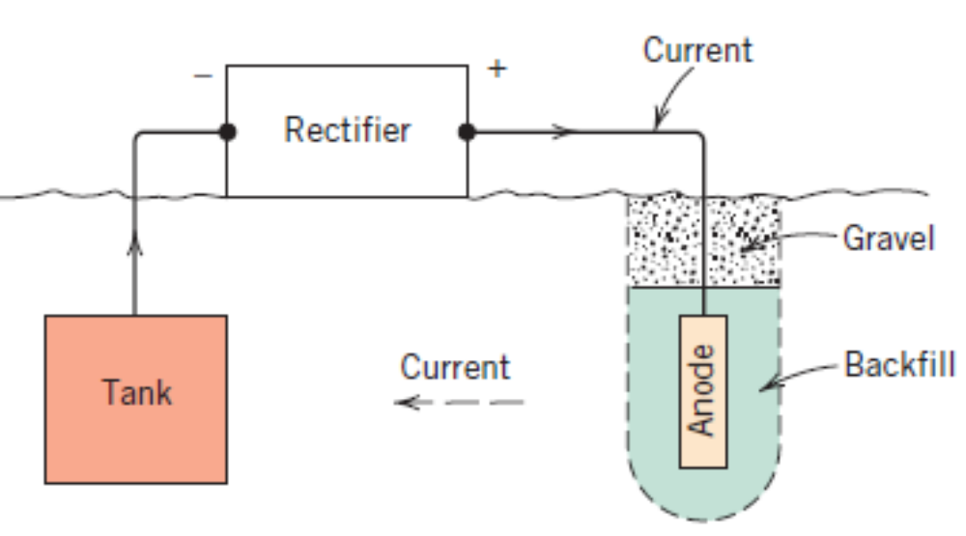
Corrosion and Degradation of Materials
Corrosion Prevention
A judicious choice of materials depending upon the type of environment.
Changing the environmental conditions such as reduced fluid velocity, temperature; modifying the concentrations in the solutions
Use of inhibitors – depending upon the type of metal
Coatings
Cathodic Protection

